Slide 1
Big Mountain Ticket Price Modeling
Carsten Bruckner
2021-06-24

Slide 2
Questions to address
Is Big Mountain competitively priced?
Which proposed facility changes make the most sense financially?

Slide 3
Key findings
Price-vs-facilities model predicts market support for adult weekend ticket price of $96 (+/- $10) without impacting ticket sales
Current price is $81
Extra $1.99/ticket value if boost vertical drop by 150ft.
Price boost yields +$3.5M revenue, vs $1.54M extra lift operation costs
Additional snowmaking in support of this doesn’t add perceived market value
Closing 10 least-used runs reduces modeled ticket price by $1.81
This ticket price drop reduces revenue by $3.2M
Cost savings ??
Increasing longest run length is revenue neutral by model

Slide 4
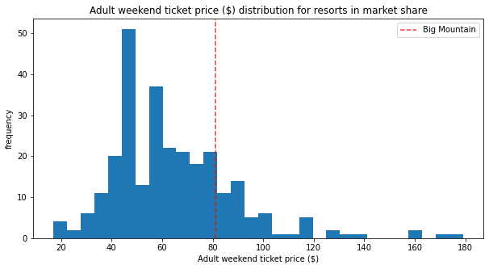
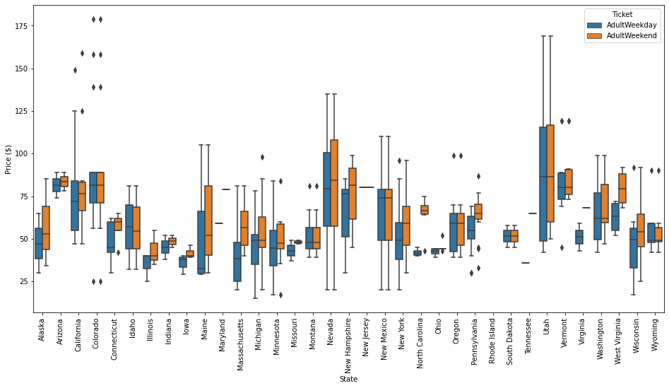
Current ticket price vs market
80%
20%

Slide 5
Selection of prediction model type and params
Isolate 30% of resorts for independent validation (“test set”)
Do following for both Linear Regression and Random Forest
For each set of evaluated model parameters
Train model on 80% of remaining 70% of data, predict on held-out 20%
Pick params with highest correlation between actual and predicted AdultWeekend ticket price for held-out 20%
With best-params model, predict prices for independent 30% test set
Select model with lower average prediction error
Training set
Test set

Slide 6

Selecting model type and parameters
Linear regression best model
Average price prediction error in test set +/- $11.79
8 features used
empty inputs replaced by median
Random forest best model
Average price prediction error in test set +/- $9.54 (better)
n_estimators = 54
empty inputs replaced by median

Slide 7
Final Model to predict Big Mountain ticket price
Refit random forest model on all data except Big Mountain
same parameters as earlier
Average price prediction error +/- $10.39
Based on 5-fold cross validation
Predict Adult Weekend ticket price with current facilities: $95.87
Current price: $81

Slide 8
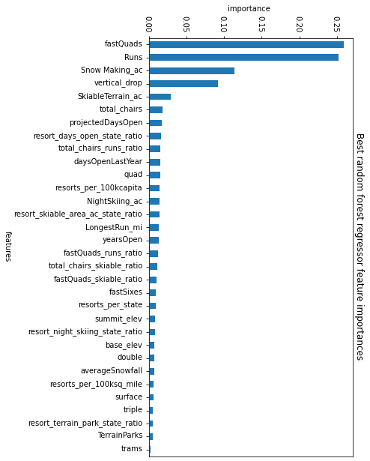
Most predictive features
“Random Forest” model
Relative importance of facilities in predicting market ticket price
Alternate best linear regression model also includes top 4 features

Slide 9
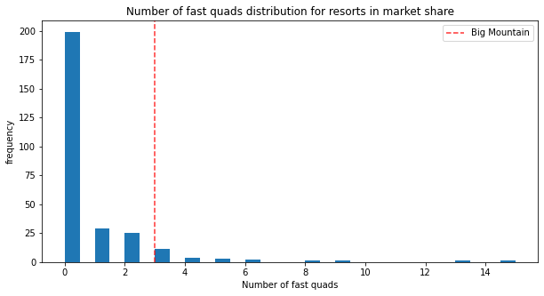
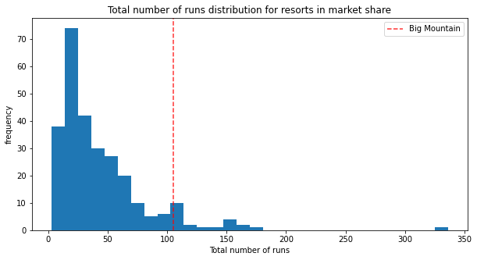
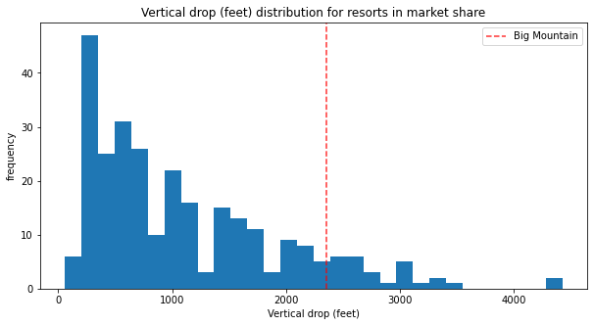
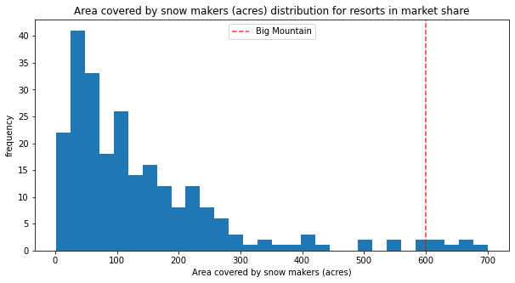
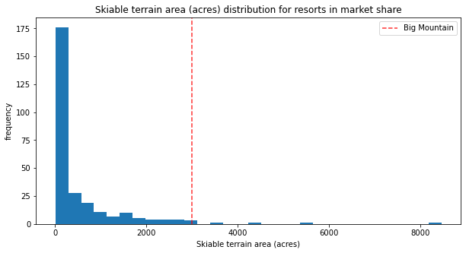
Big Mountain vs others for key assets

Slide 10
Evaluating alternative scenarios
Used same model to predict competitive ticket price if alter facility assets like
number of open runs
available vertical drop
longest run length
total snowmaking acres

Slide 11
Conclusions
Since current ticket price appears undervalued, increasing ticket price is reasonable.
Marketing increased vertical drop should easily justify increasing ticket price by at least $2.
Big Mountain predicted ticket price (and thus revenue) does not change if offset the reduction of 10 runs with additional vertical drop from a new lift. Change in profitability depend on relative operating costs of new lift vs maintaining 10 least-used runs.

